Slide 1
The Election Rush
Fatima, Shamma & Safal

Slide 2
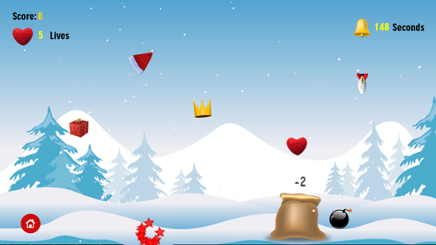
GAME DESCRIPTION
Simplified Implementation of the HTML5 based game created using Construct 2 that is the “Catcher Sack”
Goal & Theme - create a lighthearted experience ; inspiration came from United States election
A brief description of the game is that its a single player game , where the user has to rush in a horizontal movement to catch fallen images from the sky . The game will constitute of three difficulty levels. The game over happens when a constant time frame ends and when user catches maximum amount of votes.

Slide 3
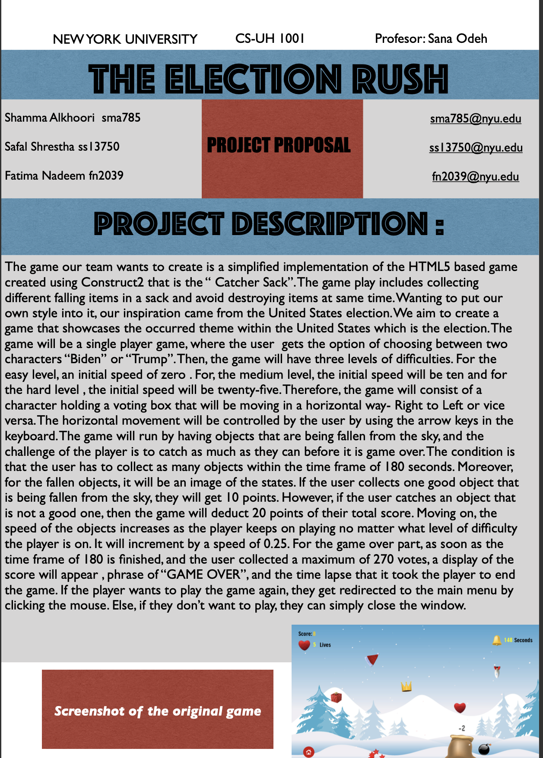
GAME INTERACTION
Single player game- user gets option of choosing between two characters “Biden” or “Trump”
Each difficulty level has different initial speed , zero, ten , then twenty-five.
Collecting different falling items in a sack :collecting image of states gives 10 points and collecting dangerous image reduces points by 20
Collecting ‘special’ objects will increase speed
The game speed keeps on incrementing by 0.25 in all levels
Horizontal movement controlled by user by the use of arrow keys
Game over when time frame of 180 seconds ends and when user collected a maximum of 270 points

Slide 4
UML
class Game:
Attributes: state difficulty character timer score
Methods: display_game display_mainscreen display_difficulty game_over drop_object add_points
class State(Object):
Attributes: image point_value
Methods: __init__(object)
class Object:
Attributes: type point_value height width ay gravity vy
Methods: drop destroy
class danger(Object):
Attributes: image point_value
Methods: __init__(object)

Slide 5
UML
class Character:
Attributes: ax ay friction vx vy character height width image direction
Methods: left right check_collision
class Biden(Character):
Attributes: image
Methods: __init__(Character)
class Trump(Character):
Attributes: image
Methods: __init__(Character)

Slide 6

WORK DISTRIBUTION
Shamma’s Tasks:
Work on game background
Work on the Falling Objects class
Work on difficulty levels
Safal’s Tasks:
Work on the characters
Work on game over conditions
Work on collision
Fatima’s Tasks:
Work on the main screen
Work on the scoring system
Work on the game environment

